Slide 1
InsurAI – Corporate Policy Automation and Intelligence System
Presented By :
Yashwanth M P

Slide 2
INTRODUCTION
InsurAi is an platform designed to automate, manage, and intelligently analyze corporate insurance policies. It aims to simplify policy management, claims processing, compliance tracking, and risk analysis for corporate clients.

Slide 3
PROBLEM STATEMENT
Managing corporate insurance policies is often manual, fragmented, and error-prone, involving large volumes of documents, renewals, compliance requirements, and claims data. Key issues include:
Time-consuming policy review and renewal processes
Difficulty in tracking compliance deadlines
Fraudulent or invalid claims slipping through manual checks
Limited data-driven insights for risk and premium optimization

Slide 4
ABSTRACT
The "InsurAl - Corporate Policy Automation and Intelligence System" is a web-based platform designed to resolve the inefficiencies of manual corporate insurance management, such as claim delays , administrative errors , and undetected fraud. The system introduces a comprehensive solution featuring role-based access for Employees, Agents, HR Admins, and System Admins. Key functionalities include the automation of policy renewals and claim eligibility checks, module for detecting fraudulent claims , and a transparent portal for employees to track their claim status in real time. Built with a Java Spring Boot backend and a React.js frontend , InsurAl aims to reduce costs, enhance efficiency, and improve transparency in corporate policy management.

Slide 5
OBJECTIVE
To design and build an automated, intelligent corporate insurance management system that:
• Simplifies policy management.
• Speeds up claim approvals.
• Enhances transparency for employees.
• Provides insights to HR and Admins.

Slide 6
PROPOSED SYSTEM
Role-based logins (Employee, Agent, HR, Admin).
Automation: Auto policy renewals.
Automatic claim eligibility checks.
Auto-generated reports (weekly, monthly, yearly).
Automated tax rule application.
Transparency: Employees can track claims and policies in real time. Automated notifications and reminders.
Fraud detection: flagging duplicate claims, unusually high amounts, and suspicious patterns.
Predictive insights for HR/Admins.

Slide 7
TECHNOLOGY STACK
Backend: Java Spring Boot (scalable, secure, enterprise-ready).
Frontend: React.js (modern, responsive UI),HTML,CSS.
Database: MySQL (structured insurance & user data).
Automation: Spring Scheduler / Quartz (renewal reminders, report scheduling).
Authentication: JWT (secure token-based login).
AI/Analytics(future): Python ML models (integrated via REST APIs, optional for fraud detection).
Emails: SMTP
Deployment (future): Docker + Cloud (AWS/Azure).

Slide 8
PROJECT WORKFLOW
MILESTONE 1 : User Registration and Authentication.
MILESTONE 2 : Policy Management, Document Management.
MILESTONE 3 : Agent Availability, Appointment Scheduling, Customer Query Management.
MILESTONE 4: Policy Enrollment, Policy Assignment, Claims Management.

Slide 9
MILESTONE 1
User Registration : A default admin is created.
Admin as access to create other admin and agent.
Corporate HR can register through register page.
HR can add new Employees to the portal.
Only Employees who are added by the admin can register and login to the portal.
Every user gets mail for registration, account activation, and password reset.

Slide 10
MILESTONE 2
Policy Management: Admin can create, edit, deactivate and activate the policies.
User can see only active policies.
Admin can only edit or manage the policy created by him.
Documents is stored locally(uses cloud in future).
Customers can view the documents.

Slide 11
MILESTONE 3
Agent Availability : Agent can change their available status.
Admin can view agents status and last seen in their dashboard.
Admin can add their available time for appointment for call, meet etc.
Appointment Scheduling : Corporate HR can view the available agent.
Book the appointment in the available timeslot.
Can rate the meeting after the slot.

Slide 12
Customer Query Management: Customers(HR, Employees) can submit their queries.
Agent gets the pending queries in their dashboard.
Agent picks up the query and resolve the query.
Customer can track the query status, notified when the query status changes.

Slide 13
MILESTONE 4
Policy Enrollment: Corporate HR can enroll to a policy.
Get the monthly premium details, pending payments , etc.
Policy Assignment: Assign the employees to the policy.
Can add or remove employee from the policy.
Claims Management : Employee can submit claims only to the policy they enrolled.
Empolyee should submit the necessary documents .
HR can view the claim and can approve by checking at first level.

Slide 14
Claims approved by HR is passed to agent.
Agent can make all the necessary verification.
Agent calculates the amount to be given to employee.
Approves and passes to Admin
Admin overviews and initiates payment.
Employee can track their claim status at each stage.
Claim can be rejected by providing necessary reasons at any stage.

Slide 15
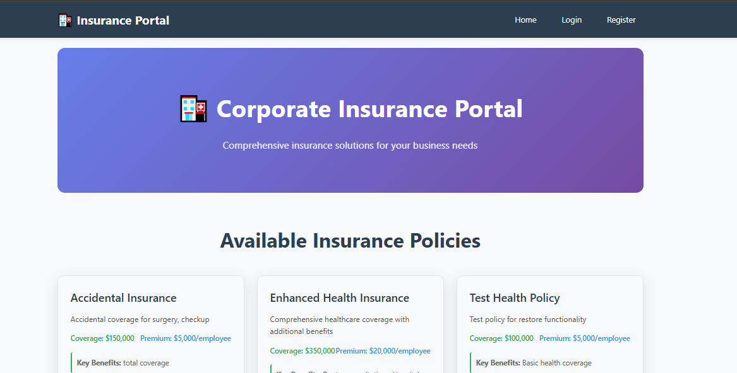
PROJECT SNAPSHOTS

Slide 16
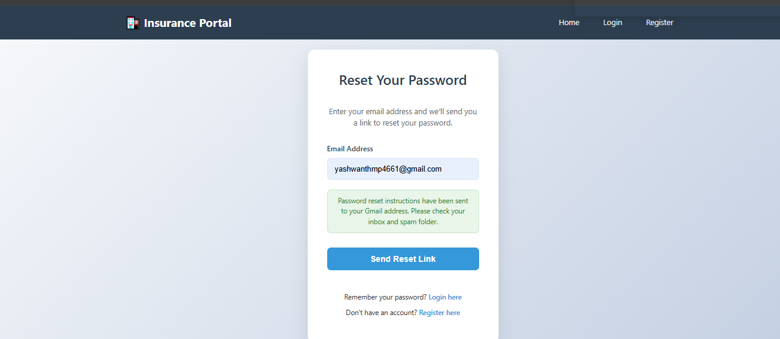
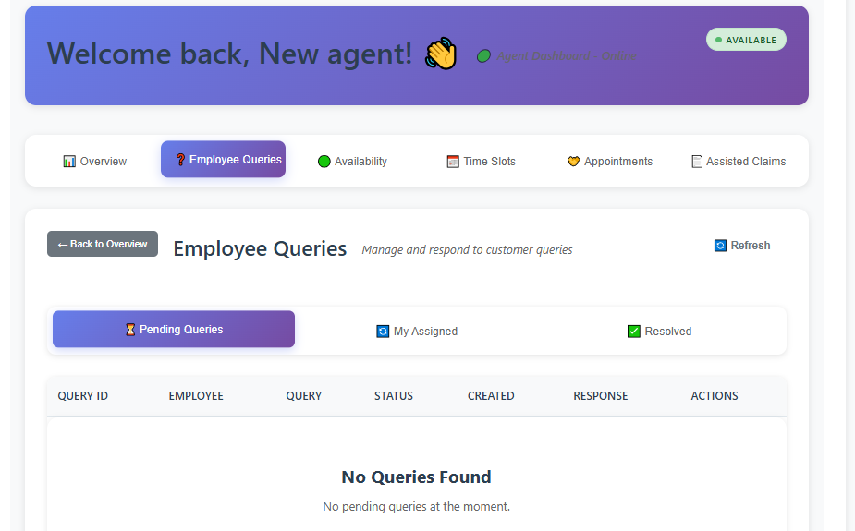
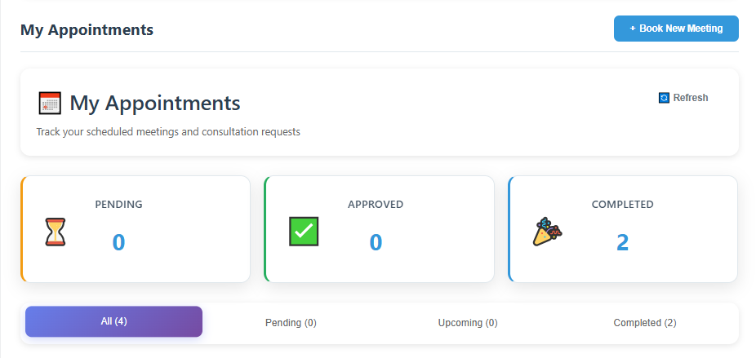

Slide 17
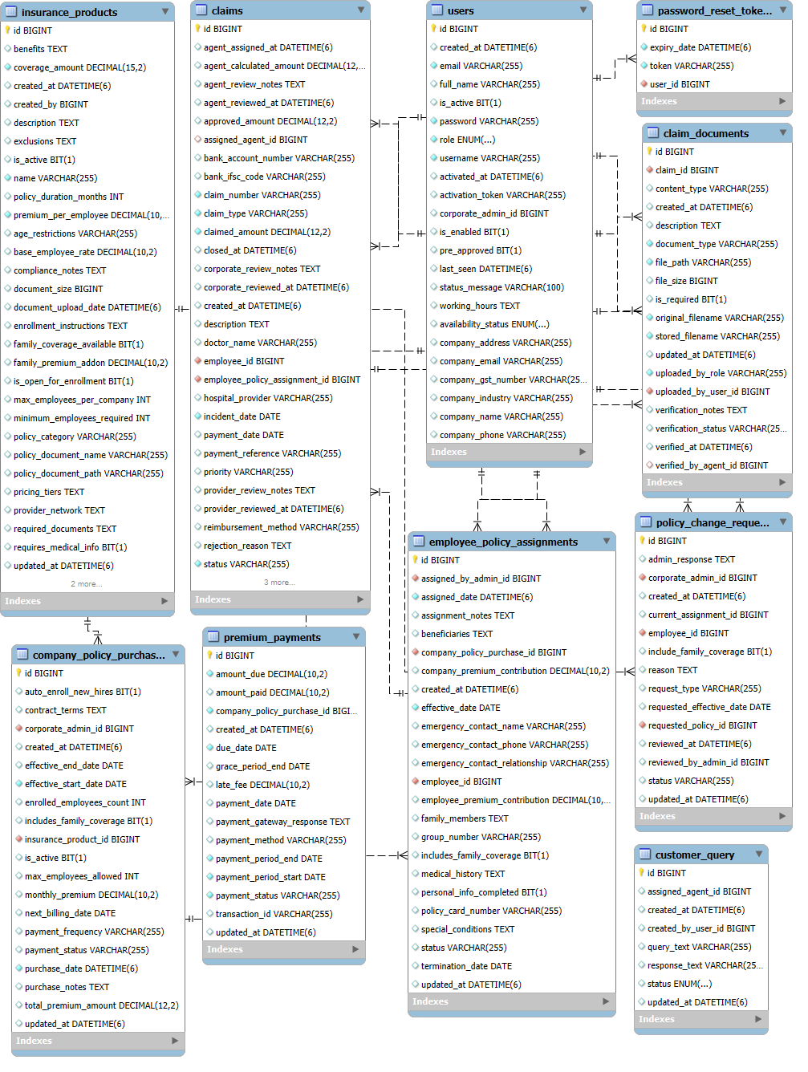
ER DIAGRAM

Slide 18
CONCLUSION
The InsurAI – Corporate Policy Automation and Intelligence System is a complete enterprise-grade solution for corporate insurance management. It combines automation, role-based access, reporting, and AI intelligence to improve efficiency, reduce fraud, and empower employees with transparency and self-service tools.
Project has gained me huge insights on latest technologies such as spring boot and react. Through this internship I have got the exposure on professional methods of project development, Team Collaboration, Version Control, etc.

Slide 19
FUTURE SCOPE
Improve Analytics for each user.
Implement AI based fraud detection.
Chatbot for Customer Query.
AI based document summarizer.
Cloud Storage for the documents.
Deployment of the project.

Slide 20
Acknowledgement
I would like to thank Infosys for giving me this opportunity.
I would like thank the mentor for guiding and supporting me in the internship journey.
I would like to thank my team members for collaborating.

